Slide 1
Progress Meeting 14/04/2020
Notes:
Useful books for creating MATLAB solver:
Fundamentals of engineering numerical analysis – Parvis Moin
Stability and transition in shear flows – Peter Schmid

Slide 3
Progress
Derived stratified system based of Orr-Somm and Squire
Began implementing the new eigenvalue problem into MATLAB

Slide 4
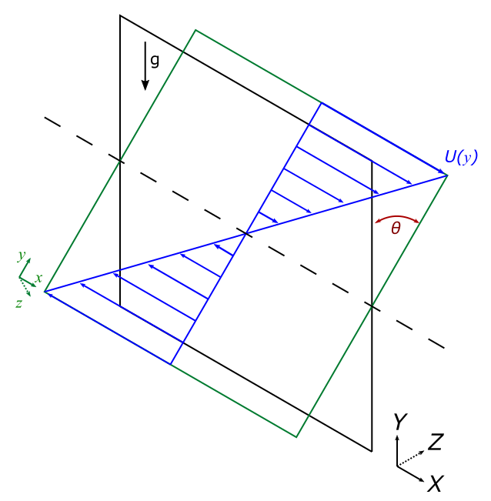
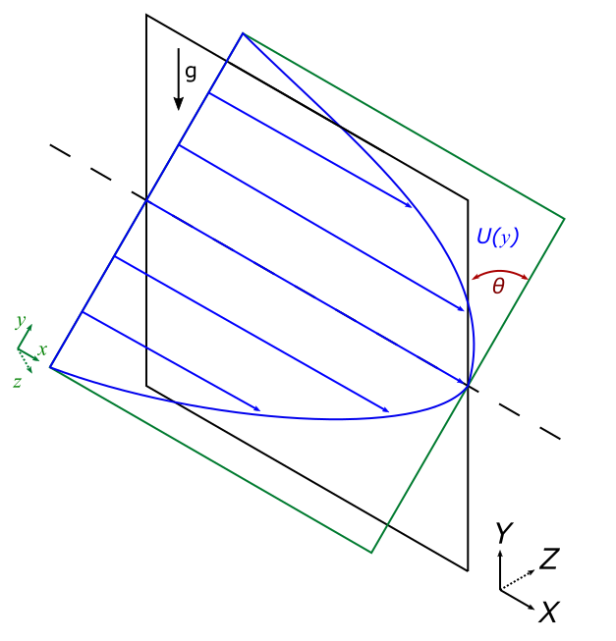
Coordinate System – Slight Change

Slide 5

State Variables
$\tilde{v}$
$\tilde{w}$
$\tilde{b}$
$\tilde{η}$

Slide 6
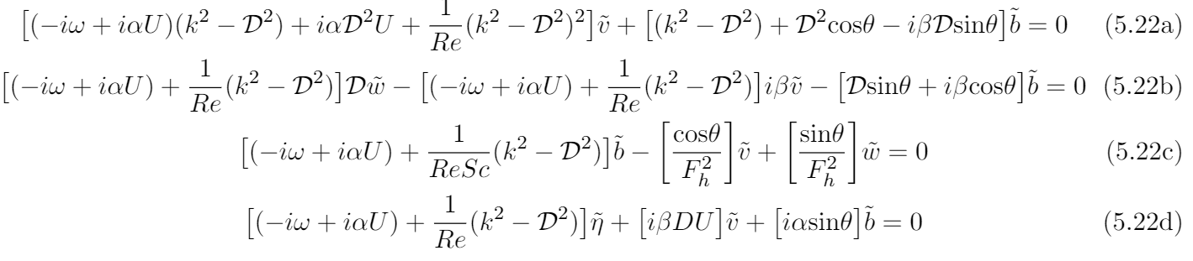

Stratified System - $\tilde{v}$

Slide 7

Stratified System - $\tilde{v}$

Slide 8

Stratified System - $\tilde{b}$

Slide 9

Stratified System - $\tilde{w}$

Slide 10

Stratified System - $\tilde{η}$

Slide 11
Stratified System - $\tilde{η}$

Slide 12
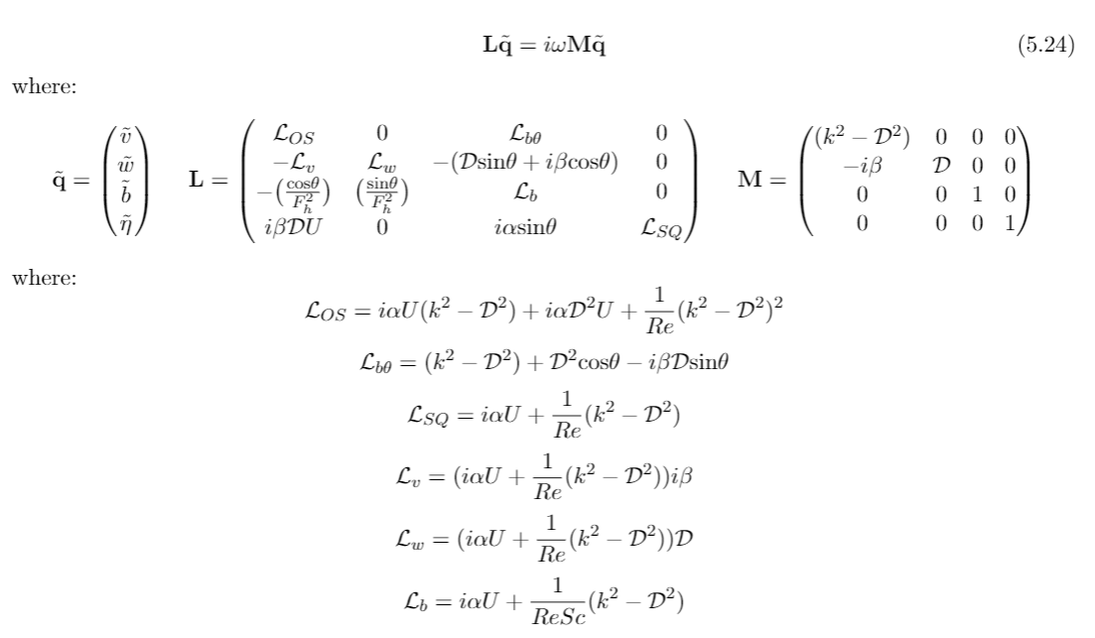
Matrix System

Slide 13
Matrix System

Slide 14
Working On…
Implementing stratified Orr-Somm eigenvalue problem into MATLAB

Slide 15
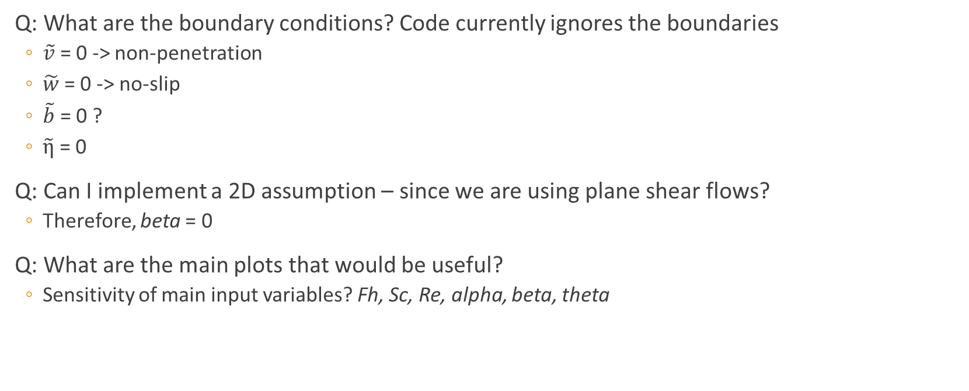
Questions
Q: What are the boundary conditions? Code currently ignores the boundaries
$\tilde{v}$ = 0 -> non-penetration
$\tilde{w}$= 0 -> no-slip
$\tilde{b}$ = 0 ?
$\tilde{η}$ = 0
Q: Can I implement a 2D assumption – since we are using plane shear flows?
Therefore, beta = 0
Q: What are the main plots that would be useful?
Sensitivity of main input variables? Fh, Sc, Re, alpha, beta, theta

Slide 16
Plan For Next Week
Complete implementation of new system into the MATLAB Solver
Carry out a mesh validation study to find the minimum number of Chebyshev points, N, when solution converges
Q: Would I have to carry out a convergence study for every case that is investigated or should I just be looking for a one value of N to use throughout?
Then begin plotting key figures of interest

